Slide 1

CSA0203- C PROGRAMMING
Student Result Processing System And Grade Generation File Based Record Processing
Student Names:
R. Jaideep(192525441)
B. Bhanu Prakash(192412518)
P. Jeevan Kumar(192572090)
Guided By:
Dr.Saravanan Kaliaperumal

Slide 2


Introduction
Student Result Processing and Grade Generation System is programming.
developed using C
The project uses File-Based Record Processing to store student records permanently.
It automates the calculation of total marks, percentage, and grade.
Student records can be added, viewed, searched, updated, and deleted.
The system provides a menu-driven interface for easy operation.
It uses Structures, File Handling, Functions, Loops, and Conditional Statements in C.

Slide 3
Problem Statement
Student result processing is often done manually, which is time-consuming.
Manual calculation of total marks, percentage, and grades can lead to errors.
Maintaining student records on paper is difficult and records may be lost or damaged.
Searching and updating student information manually is inefficient.
There is a need for a simple system that stores student records permanently and generates results automatically.

Slide 4
Abstract
The Student Result Processing and Grade Generation System is a C programming application that simplifies the management of student academic records using file-based record processing.
The system stores student details permanently, automatically calculates total marks, percentage, and grades, and provides options to add, view, search, update, and delete records.
It reduces manual effort, improves accuracy, and demonstrates the practical use of C programming concepts such as file handling, structures, functions, and conditional statements in developing a simple student management system.

Slide 5
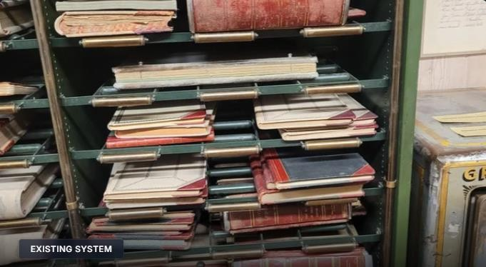
Existing System
Student records are maintained manually using paper or registers.
Result calculation and grade generation are done manually.
Manual processing is time-consuming and prone to errors.
Searching and updating student records is difficult.
Records may be lost or damaged due to improper storage.

Slide 6

Proposed System
Develop a C-based Student Result Processing System using file handling.
Store student records permanently in files.
Automatically calculate total marks, percentage, and grades.
Provide options to add, view, search, update, and delete student records.
Reduce manual errors and improve result processing efficiency.

Slide 7

Functionality
Add new student records.
View all student records.
Search student details using Roll Number.
Update existing student records.
Delete student records.
Calculate total marks, percentage, and grade automatically.
Store and retrieve records using file handling.

Slide 8

Module 1: Student Marks Entry Module
Collects student details and subject marks.
Takes Roll Number and Student Name.
Accepts marks for each subject.
Validates the entered marks.
Stores the student data using file handling.

Slide 9
Module 1: Student Marks Entry Module
struct Student {
int roll;
char name[50];
int marks[5];
};
struct Student s;
printf("Enter Roll Number: ");
scanf("%d", &s.roll);
printf("Enter Student Name: ");
scanf("%s", s.name);
for(int i = 0; i < 5; i++) {
printf("Enter Marks: ");
scanf("%d", &s.marks[i]);
}
“In the first module, we collect the student's roll number, name and five subject marks. We use a structure to store all student information, and a loop is used to enter the subject marks efficiently.”

Slide 10
Module 2: Evaluation Processing Module
Calculates the total marks.
Calculates the percentage.
Checks the student's performance.
Reads the stored student marks.
Processes the marks automatically.

Slide 11
Module 2: Evaluation Processing Module
s.total = 0;
for(int i = 0; i < 5; i++) {
s.total += s.marks[i];
}
s.percentage = s.total / 5.0;
“In the second module, the entered marks are processed. The program adds all five subject marks using a loop and calculates the total. Then the percentage is calculated from the total marks.”
“Why loop?”
“The loop avoids writing separate statements for every subject and makes the program easier to modify.”

Slide 12
Module 3: Grade Calculation & Result Processing Module
Displays marks, percentage, and grade.
Stores the processed result.
Provides the final result to the user.
Determines the grade based on percentage.
Generates the student's final result.

Slide 13
Module 3: Grade Calculation & Result Processing Module
if(s.percentage >= 90)
s.grade = 'A';
else if(s.percentage >= 80)
s.grade = 'B';
else if(s.percentage >= 70)
s.grade = 'C';
else if(s.percentage >= 60)
s.grade = 'D';
else
s.grade = 'F';
if(s.percentage >= 50)
printf("PASS");
else
printf("FAIL");
“In the third module, the calculated percentage is used to generate the grade. The program also checks the pass condition. If the percentage is 50 or above, the result is PASS; otherwise it is FAIL.”

Slide 14

Algorithms
Start the program.
Display the main menu.
Select the required operation (Search/Update/Delete).Read or modify student data.
Calculate total, percentage, and grade.
Store or retrieve records from the file.
Display the result.
Repeat until the user chooses Exit.
Stop the program.

Slide 15
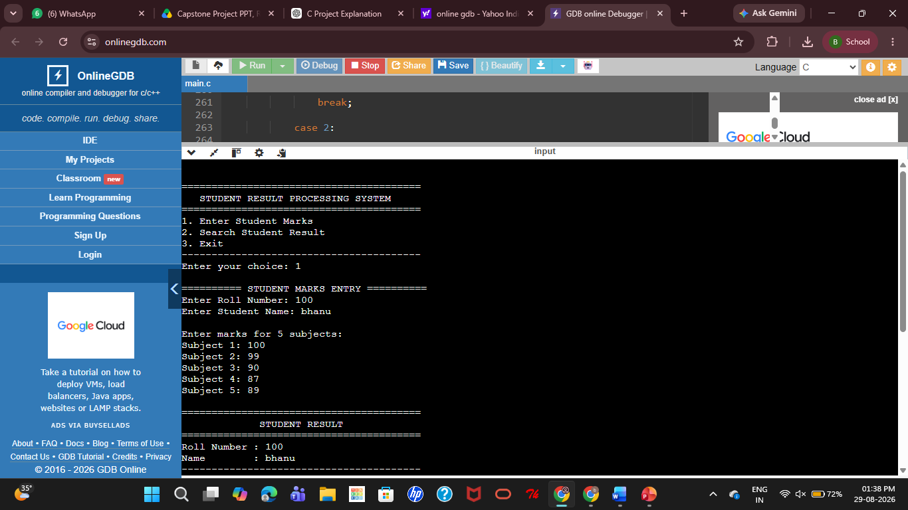
OUTPUT

Slide 16
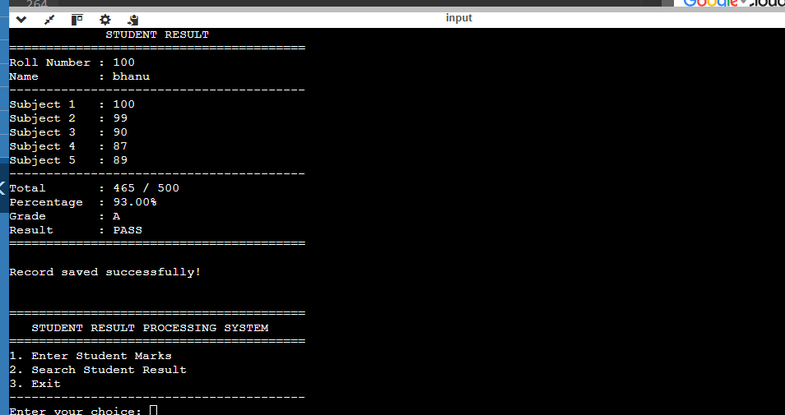
OUTPUT

Slide 17
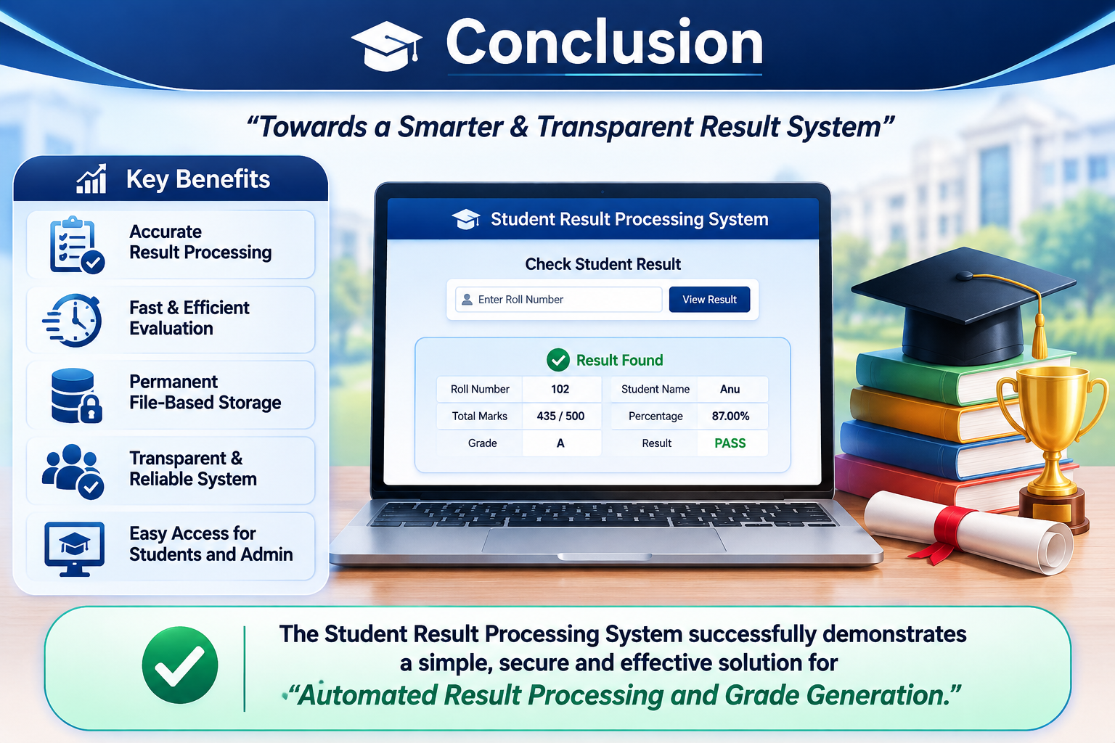
Conclusion
The project provides a simple and efficient
student result management system.
It automates the calculation of total marks, percentage, and grades. File handling ensures permanent storage of student records.
The system reduces manual effort, minimizes errors, and improves accuracy.
It demonstrates the practical application of C programming and file handling.

Slide 18
References
Balagurusamy, E. (2024). Programming in ANSI C (9th ed.). McGraw Hill Education.
Kanetkar, Y. P. (2024). Let Us C (20th ed.). BPB Publications.
Thareja, R. (2023). Programming in C (3rd ed.). Oxford University Press.
Dubey, V., Deep, P., Anand, J., & Kumar, L. (2025). File Handling in C Programming. Chyren Publication. https://doi.org/10.5281/zenodo.16145913
Kumar, S., Mangal, S., & Singh, A. (2024). Supervision of College Management Using Database Management System. Journal of Advanced Database Management Systems, 11(2).

Slide 19
THANK YOU

